Slide 1
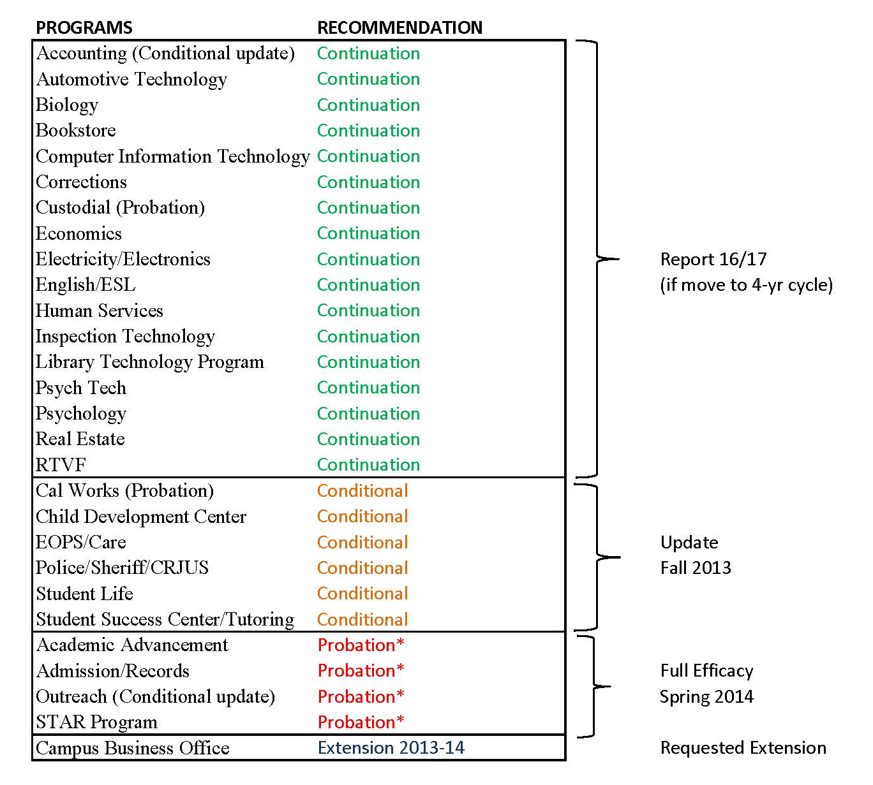
Efficacy Review – Spring 2013

